Slide 1

INTRODUCTION
Title: Music Recommendation App
January, 31 2025
Spotify
By: MACDONALD OSAKWE

Slide 2

CONTENT:
Purpose: To build a music recommendation app using Spotify data.
Goal: Help users discover similar songs based on their preferences using song features like energy, danceability, and tempo.
Features:
Recommend songs from a curated dataset.
Display song images and audio clips using the Spotify API.
By: MACDONALD OSAKWE

Slide 3
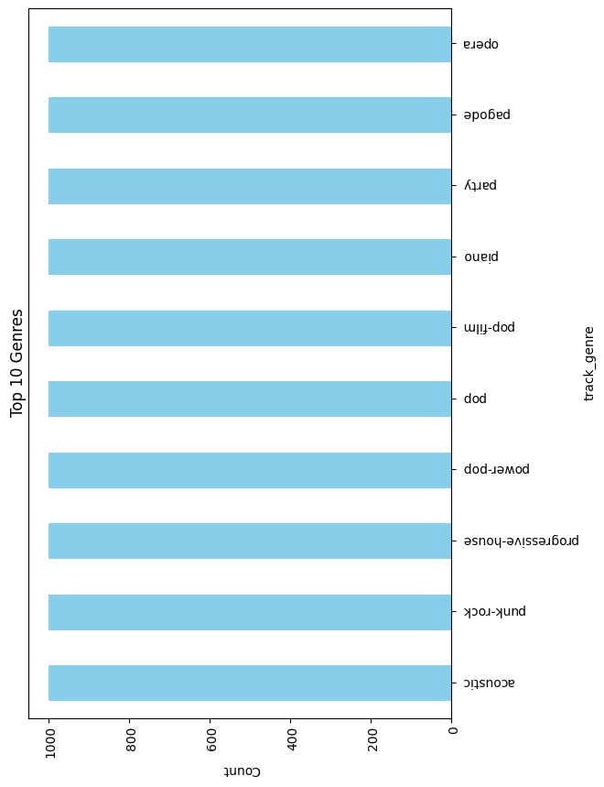
DATA EXPLORATION
Content:
Bar Chart for Top 10 Genre
Fields: track_name, artists, danceability, energy, valence, etc.
Size: 100,000 tracks.
Key Steps
Checked for missing/duplicate values.
Visualized features like popularity, danceability, and genres to understand trends.
Insights:
Higher danceability is common in popular tracks.
Genres like pop and rock dominate the dataset.
By: MACDONALD OSAKWE

Slide 4
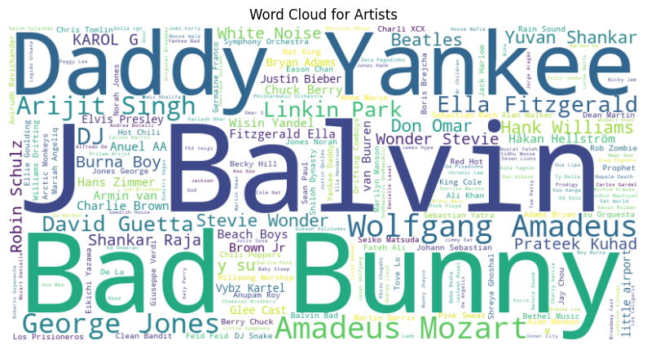
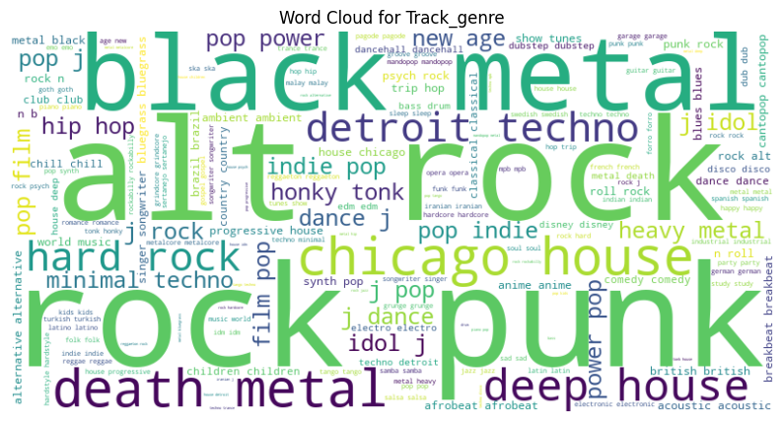
Word Cloud Generated for Artist:
Word Cloud Generated for Track Genre:
By: MACDONALD OSAKWE

Slide 5
MODELLING:
Recommendation Algorithm
Used KMeans Clustering
Compute Similarities
Spotify Integration:
Used KMeans clustering to group songs based on audio features like loudness, danceability, etc.
Computed cosine similarity to recommend songs closest to the selected track in feature space.
Retrieved song images and audio previews using Spotify’s API.
By: MACDONALD OSAKWE

Slide 6
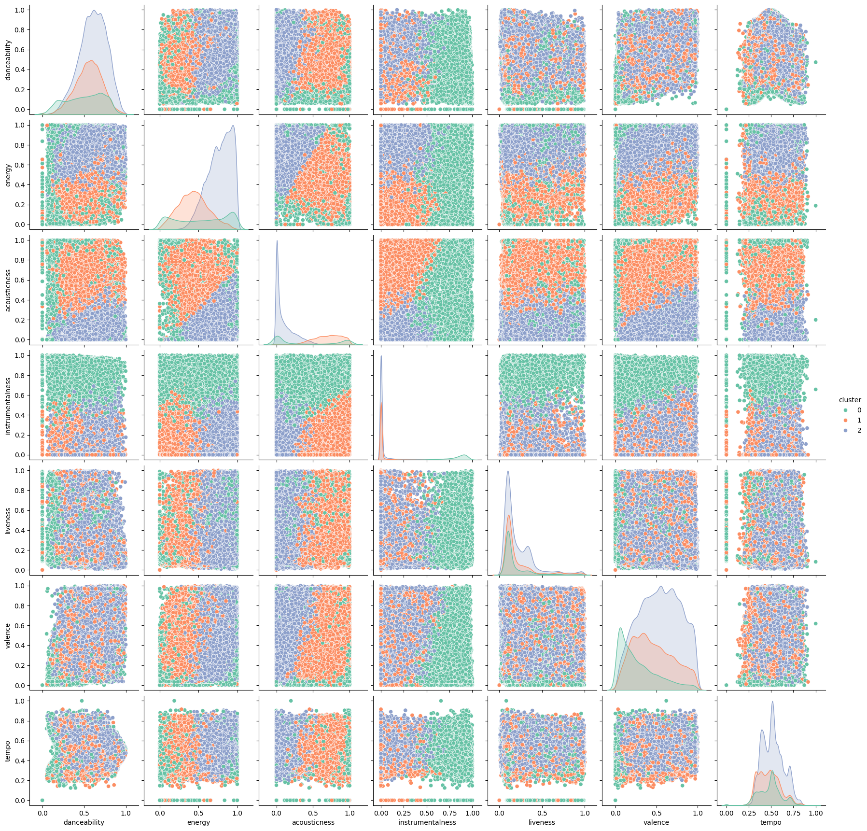
SCATTER PLOT:CLUSTERS VISUALIZATION BY FEATURES
By: MACDONALD OSAKWE

Slide 7

CHALLENGES AND LIMITATION
Some tracks lack audio previews due to API restrictions.
Recommendations depend heavily on feature similarity, not user listening history.
Dataset may not reflect the latest songs or trends.
Full audio streaming isn’t available due to licensing restrictions.
By: MACDONALD OSAKWE

Slide 8

DEPLOYMENT WITH STREAMLIT
Framework:
Built a Streamlit app with an intuitive user interface.
Sidebar for settings (Spotify logo, number of recommendations).
Main page: Song selection dropdown and 3-column grid for Recommendations.
Design:
Color scheme: Black and green (Spotify theme).
Dynamic API calls to display images and audio previews.
Hosting: Deployed on Streamlite Cloud for accessibility.
Link:
By: MACDONALD OSAKWE

Slide 9
KEY TAKEAWAYS
Explored and prepared Spotify data for modeling
Used clustering and cosine similarity to recommend songs.
Integrated Spotify API for images and audio.
Built and deployed an engaging app using Streamlit.
By: MACDONALD OSAKWE

Slide 10
FUTURE IMPROVEMENTS
Implement a user rating system (thumbs up/down or a star rating) for recommended songs.
Collect user interactions (e.g., songs they skip or play frequently) to refine future recommendations.
Allow users to provide explicit feedback, such as selecting a preferred genre, mood, or artist.
Expand Dataset with Newer Tracks and Genres
Regularly update the dataset by integrating APIs that provide new song releases.
Include a diverse range of genres to cater to different user preferences.
Ensure that trending songs and emerging artists are included to keep recommendations relevant.
Use web scraping or third-party datasets to supplement missing or outdated data.
Integrate Other APIs (e.g., YouTube or SoundCloud)
Incorporate YouTube API to fetch music videos or extended previews for recommendations.
Offer multiple streaming options (Spotify, YouTube, SoundCloud) so users can choose their preferred platform.
Enhance the recommendation model by incorporating metadata from these APIs, such as song popularity, user comments, or play counts.
By: MACDONALD OSAKWE

